Slide 1
NAHMA
Government Affairs Committees
Update January 2020

Slide 2

Happy New Decade!

Slide 3
GR Committees and Leadership
Federal Affairs – Ch. Kimberlee Schreiber, VCh. Jack Sipes
  Advocacy Task Force – Ch. David Joyner, VCh. Amy Albery
Regulatory Affairs – Ch. Cindy Lamb, VCh. Lisa Beffa
Tax Credit – Ch. John Kuppens, VCh. Scott Hunley
Senior Housing – Ch. Nancy Evans, VCh. Jeff Kohler
Rural Housing – Ch. Noel Gill, VCh. Bert Loe
Fair Housing – Ch. Anita Moseman, VCh. Debbie Piltch

Slide 4
GR Committees – Joint Call
Key Items for Member Input:
  Regulatory Barriers, Lead-based health hazards, LIHTC Compliance monitoring, NSPIRE demo, RD and Tax
Current Updates from Washington
  Funding, CRA reform, Rural Development, Legislation, Fair Housing, RAD for PRAC, services demo, TRACS
Next Steps for NAHMA’s GR Committees
  March Meeting planning, committee agendas, call schedules

Slide 5
Key Items for Discussion

Slide 6
Regulatory Barriers to Development
White House Council on Eliminating Regulatory Barriers to Affordable Housing
Comments Request on Laws, regulations, land use requirements, and administrative practices that:
  Increase costs of affordable housing development
  Contribute to shortages in housing supply
  Recommendations, policy solutions, performance metrics
Comments due to NAHMA Jan 15; due to HUD Jan 21

Slide 7
Government Accountability Office (GAO)
Examining HUD’s Oversight of Lead-based Paint
What programs and activities do HUD and EPA have in place for identifying and addressing lead-based paint hazards in affordable rental housing?
How do HUD and EPA determine whether methods for addressing lead-based paint in affordable rental housing are effective and how do they communicate information about these methods?
To what extent does HUD’s approach to overseeing its lead-based paint regulations help the agency identify and address lead–based paint hazards in the PBRA program?
NAHMA will be interviewed by GAO in last week in January. GAO may reach out to members, independently.
NSPIRE Demonstration Underway
Highly-unlikely 4,500 properties are in the Demo…
What are member thoughts/concerns?

Slide 8
LIHTC Compliance Monitoring
IRS updated regs in Feb 2019
  Sample size: agencies must inspect no fewer units than the Low-Income Housing Credit Minimum Unit Sample Size Reference Chart; maintains the “all buildings” rule
  Inspection Notification: Shorten the reasonable notice requirement to 15 days in advance of physical inspection or review of low-income certification (from current 30 days)
Built into QAPs this year
Member concerns?
  NAHMA following up with IRS to push for adjustments

Slide 9
Minimum unit sample
size based on number of low-income units in a project
1 ................................ 1
2 ................................ 2
3 .............................. 3
4 ................................ 4
5–6 ............................ 5
7 ................................ 6
8–9 ............................ 7
10–11 ........................ 8
12–13 ........................ 9
14–16 ........................ 10
17–18 ........................ 11
19–21 ........................ 12
22–25 ........................ 13
26–29 ........................ 14
30–34 ........................ 15
35–40 ........................ 16
41–47 ........................ 17
48–56 ........................ 18
57–67 ........................ 19
Updates to Minimum Sample Size:
Previous temporary regulations allowed Credit agencies to inspect the lesser of 20 percent of the total number of units OR the number of units in the Minimum Unit Sample Size Reference Chart
Updated regs require agencies to inspect based on the chart
New regs result in sample sizes lower than 20 percent of large projects but higher than 20 percent for small projects
Agencies may inspect more units than the minimum requirement at their discretion
On-site inspections in units in all buildings in the same project
68–81 ........................ 20
82–101 ...................... 21
102–130 .................... 22
131–175 .................... 23
176–257 .................... 24
258–449 .................... 25
450–1,461 ................. 26
1,462–9,999 .............. 27

Slide 10
Rural Development and LHTC; Forms
NAHMA compiling feedback for RHS staff – options for improving processes
  Challenges working with RD and Tax Credits
  Issues with current forms
  Ideas for improvements? Streamlining?
  Other areas for constructive feedback?

Slide 11
Current Updates

Slide 12
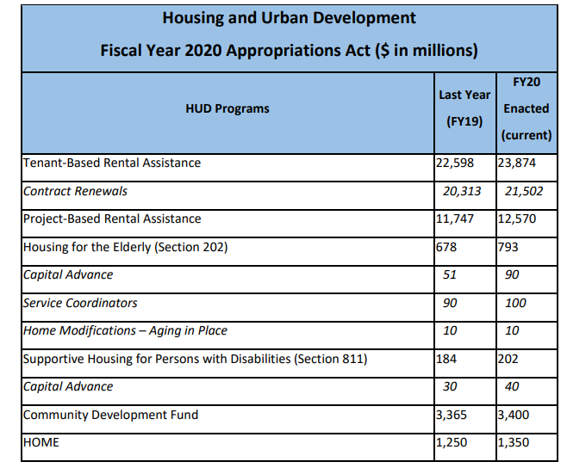
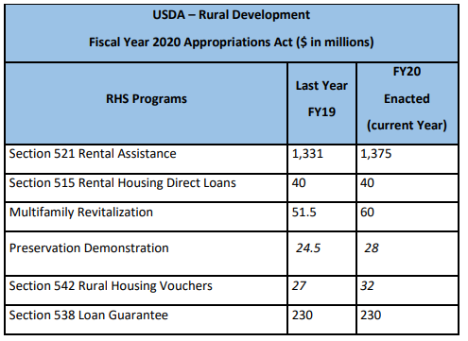
FY20 Funding Levels- Overall Positive
NAHMAnalysis Available

Slide 13
Community Reinvestment Act
Office of the Comptroller of the Currency (OCC) and the Federal Deposit Insurance Corporation (FDIC) proposes to modernize the Community Reinvestment Act (CRA).
  Federal Reserve, will likely not signed on to this proposed rule
  Proposes overhauling CRA assessment boundaries, eligible activities, banks’ reporting regimes, and how banks are scored overall for their performance
  Introduces a new "50%-5%" breakdown:
    require banks that receive more than 50 percent of its deposits from areas not tied to its physical branches to analyze the reported locations of its depositors and consider any zones that have a concentration of more than 5 percent of the bank's deposits as new CRA assessment areas.
    banks would be evaluated on the basis of both the total unit number of CRA-eligible loans and the total dollar amount lent to projects benefiting low-to-moderate-income communities.
  Regulators would develop a frequently updated list of commonly approved CRA activities, streamline the structure of CRA exams, and calculate CRA investment on an average, ongoing basis
NAHMA will work with Industry partners to draft comments.
  Industry is concerned about impact on LIHTC and affordable housing financing

Slide 14
Rural Development – Agency Updates
Multi-Family Preservation and Revitalization Program
  Agency working on 2019 MPR NOFA; notice will elevate eligibility for “no-cost” properties (straight deferral/transfer properties where no 515 funding is needed)
  Focus on clearing backlog (3 fiscal years of backlog unless Congress appropriates more funding)
Portfolio “Risk-Ranking” for Preservation Priorities
  Ranking based on need/developing comprehensive strategy
  Data to be made public in Spring 2020, but individual property “ranks” will not be disclosed for privacy reasons
New approaches to rural housing challenges
  Piloting different types of assistance models for rental assistance

Slide 15
Advocacy Updates
Hill Visits – Another record-setting year
  Focus on preparation, quality of meetings
  65 Hill Visits in October
  Thank you to advocacy “veterans” and “newbies”
Announcing 2019 Advocacy Challenge Winners
  First Place: NEAHMA
  Runner Up: JAHMA/PennDel AHMA
Next Steps
  Survey Input
  Upcoming Task Force call to set priorities for the year

Slide 16
Fair Housing
New Proposed Rule issued on Affirmatively Further Fair Housing (AFFH)
  AFFH largely suspended since 2018, due to burden/complexity
  Updates definition of AFFH and aims to increase “fair housing choice”:
    “individuals and families to have the opportunity and options to live where they choose, within their means, without unlawful discrimination related to race, color, religion, sex, family status, national origin, or disability.”
  CDBG jurisdiction that submits a Consolidated Plan (Con Plan)
    submit with it an AFFH certification
    commit to addressing at least 3 obstacles to fair housing choice or fair housing goals over the next 5 years.
  HUD will use publicly available metrics to score and rank jurisdictions
    Based on a comparison of similar jurisdictions that submit a Con Plan in the same year
    Incentives for jurisdictions that score well and show significant improvement
NAHMA will take comments through February 14

Slide 17
TRACS
  Industry Working Group Conference, Jan. 14-15, HUD HQ
Senior Housing
  RAD for PRAC
  Senior Services Demonstration
LIHTC Data Transfer
  New Forum platform hosted by NAHMA
  http://lihtcdatastandard.proboards.com/
  File transfer pending

Slide 18
Legislative Updates
Congressional focus in the 116th Congress
  Tax Credits – Affordable Housing Credit Improvement Act; Qualified Contracts; Renters’ tax credits
  Investments – Infrastructure; capital needs; green retrofitting; combatting homelessness; new construction, studying impacts
  Opportunity – Opportunity Zones; Housing Mobility
  Fair Housing – VAWA; Evictions; Fair Housing Act protections
  Rural and Tribal Housing – Preservation; targeting resources
  Hearings – HUD oversight; homelessness; CRA and finance

Slide 19
Legislative Updates
Upcoming 2020 Congressional Hearings:
  January 9: Understanding the Importance of DHS Preparedness Grants: Perspectives from the Field
  January 14: On the Brink of Homelessness: How the Affordable Housing Crisis and the Gentrification of America Is Leaving Families Vulnerable
  January 14: The Community Reinvestment Act: Reviewing Who Wins and Who Loses with Comptroller Otting’s Proposal
  January 14: Making HUD-VASH Work for all Veteran Communities

Slide 20
2020 Outlook - Next steps
March Meeting
Agenda Setting
Committee Calls

